Slide 1
Lecture 2 Data Preprocessing and Model Evaluation
CS 180 – Intelligent Systems
Dr. Victor Chen
Fall 2022

Slide 2
Data Preprocessing

Slide 3
What is Data?
Attributes
Data include objects and their attributes
An object means an entity in the world
Examples: person, transaction, image
Object is also known as record, point, sample, or instance
An attribute is a property of an object
Examples: name, date of birth, height, occupation are attributes of person.
Attribute is also known as field, or feature
Objects

Slide 4
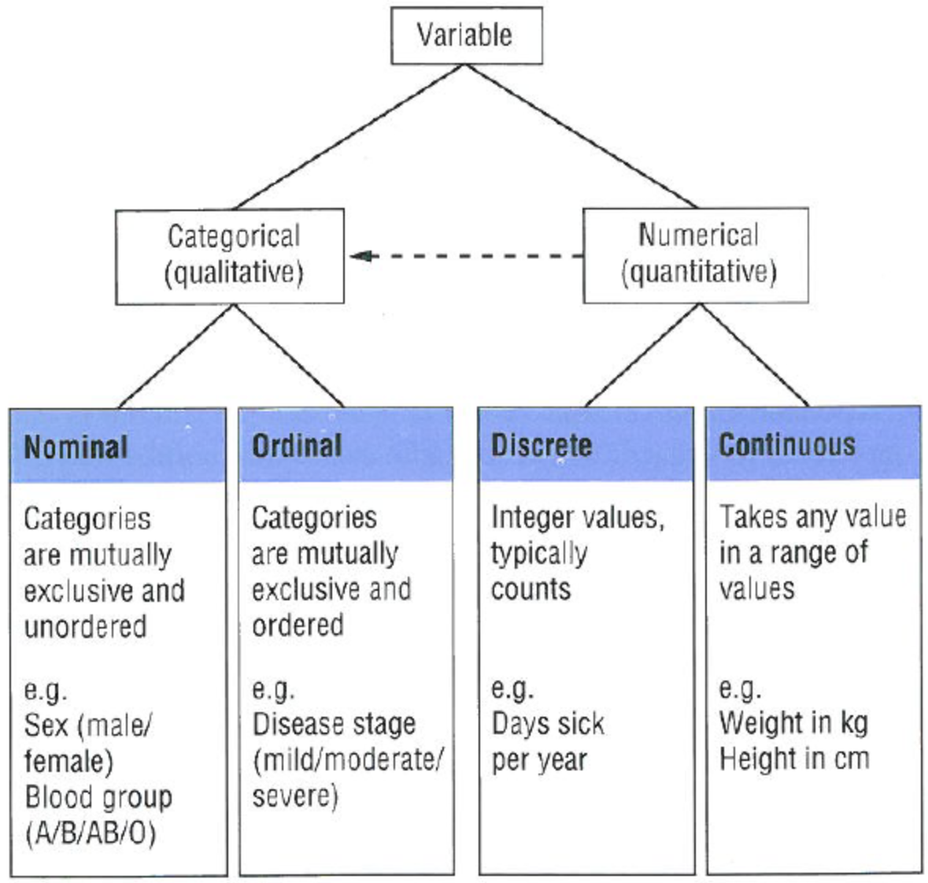
Numeric and Categorical Data
Attributes can be:
Numeric
Examples: dates, temperature, time, length
Discrete vs Continuous
Categorical
Examples: eye color, rankings (e.g, good, fair, bad), height in {tall, medium, short}
Nominal (no order) vs Ordinal (ordered but not comparable)

Slide 5
If an attribute is categorical….

Slide 6
Data Encoding
If an attribute is categorical, we must convert it from categorical to numeric.
ID Number | Zip Code | Age | Marital Status | Income | Income Bracket | Refund
1129842 | 45221 | 55 | Single | 250000 | High | No
2342345 | 45223 | 25 | Married | 30000 | Low | Yes
1234542 | 45221 | 45 | Divorced | 200000 | High | No
1243535 | 45224 | 43 | Single | 150000 | Medium | No

Slide 7
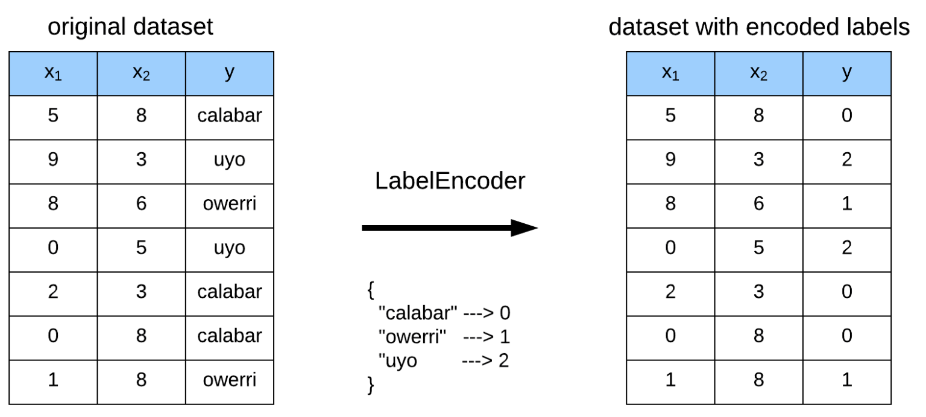
Label Encoding
Label Encoding: Assign one unique number to each distinct value

Slide 8

Never use label encoding on input features

Slide 9
Data Encoding
How to convert the feature “Zip Code” from categorical to numeric?
ID Number | Zip Code | Age | Marital Status | Income | Income Bracket | Refund
1129842 | 45221 | 55 | Single | 250000 | High | No
2342345 | 45223 | 25 | Married | 30000 | Low | Yes
1234542 | 45221 | 45 | Divorced | 200000 | High | No
1243535 | 45224 | 43 | Single | 150000 | Medium | No

Slide 10
Data Encoding
One hot Encoding: For each distinct value, we create a new binary feature
ID | Zip 45221 | Zip 45223 | Zip 45224 | Age | Single | Married | Divorced | Income | Refund
1129842 | 1 | 0 | 0 | 55 | 1 | 0 | 0 | 250000 | 0
2342345 | 0 | 1 | 0 | 25 | 0 | 1 | 0 | 30000 | 1
1234542 | 1 | 0 | 0 | 45 | 0 | 0 | 1 | 200000 | 0
1243535 | 0 | 0 | 1 | 43 | 1 | 0 | 0 | 150000 | 0
Thinking of records as vectors is very useful, which allows us to use linear algebra to process data.

Slide 11
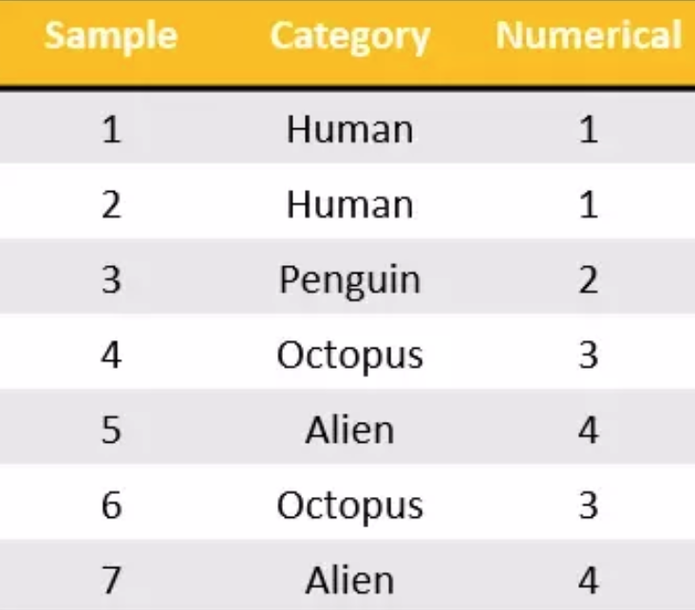
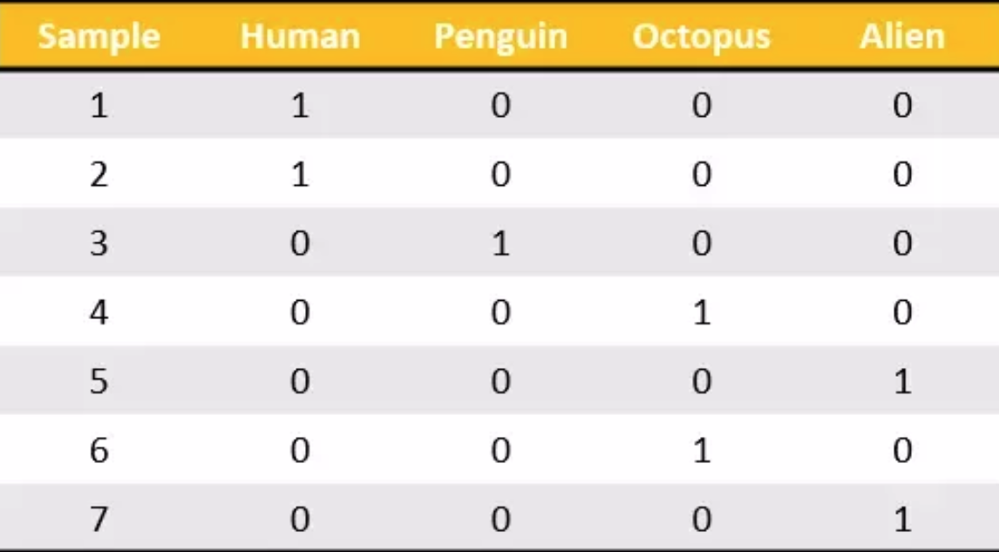
Another example: One hot encoding

Slide 12
If an attribute is numeric….

Slide 13
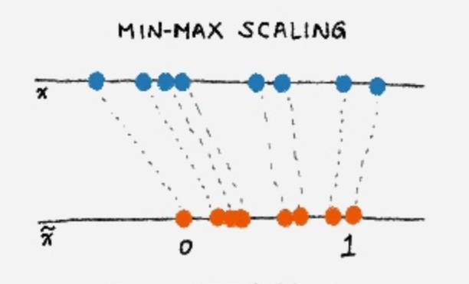
Data normalization
If an attribute is numeric, we must normalize that attribute rather than using raw values

Slide 14
Normalization on numeric data
Different attributes take very different range of values.
We need to make them comparable
Temperature | Humidity | Pressure
30 | 0.8 | 90
32 | 0.5 | 80
24 | 0.3 | 95

Slide 15
Normalization – option 1
Divide raw values by the maximum value
Brings everything in the [0,1] range
Temperature | Humidity | Pressure
0.9375 | 1 | 0.9473
1 | 0.625 | 0.8421
0.75 | 0.375 | 1
new value = old value / max value in the column
Temperature | Humidity | Pressure
30 | 0.8 | 90
32 | 0.5 | 80
24 | 0.3 | 95

Slide 16
Normalization --- option 2
Subtract the minimum value and divide by the difference of maximum value and minimum value
Brings everything in the [0,1] range
Temperature | Humidity | Pressure
0.75 | 1 | 0.33
1 | 0.6 | 0
0 | 0 | 1
new value = (raw value – min column value) / (max col. value –min col. value)
Temperature | Humidity | Pressure
30 | 0.8 | 90
32 | 0.5 | 80
24 | 0.3 | 95

Slide 17
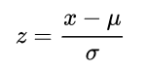
Normalization --- option 3
The standard score, z, of a raw value x is
where:
μ is the mean.
σ is the standard deviation.
Standard scores are also called z-scores
z score is negative when the raw value is below the mean, positive when above

Slide 18


Natural Language Processing

Slide 19
Overview
Bag-of-words (BoW) model
TF-IDF model

Slide 20
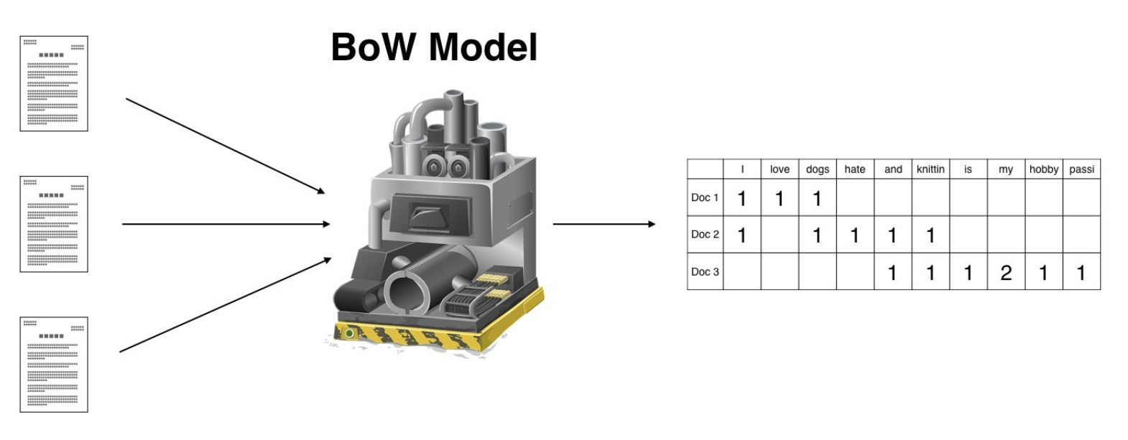

Slide 21
Document data
Doc Id | Words
1 | the, dog, followed, the, cat
2 | the, cat, chased, the, cat
3 | the, man, walked, the, dog

Slide 22
Bag-of-words (BoW) model
Create a feature for each unique word
Each vector is defined over all possible words (vocabulary)
The values are counts (number of times a word appears in the document, i.e., occurrence frequency)
Doc Id | the | dog | follows | cat | chases | man | walks
1 | 2 | 1 | 1 | 1 | 0 | 0 | 0
2 | 2 | 0 | 0 | 2 | 1 | 0 | 0
3 | 1 | 1 | 0 | 0 | 0 | 1 | 1
Doc Id | Words
1 | the, dog, follows, the, cat
2 | the, cat, chases, the, cat
3 | the, man, walks, the, dog
Sparsity: Most entries are zero. Most documents contain few of the words

Slide 23
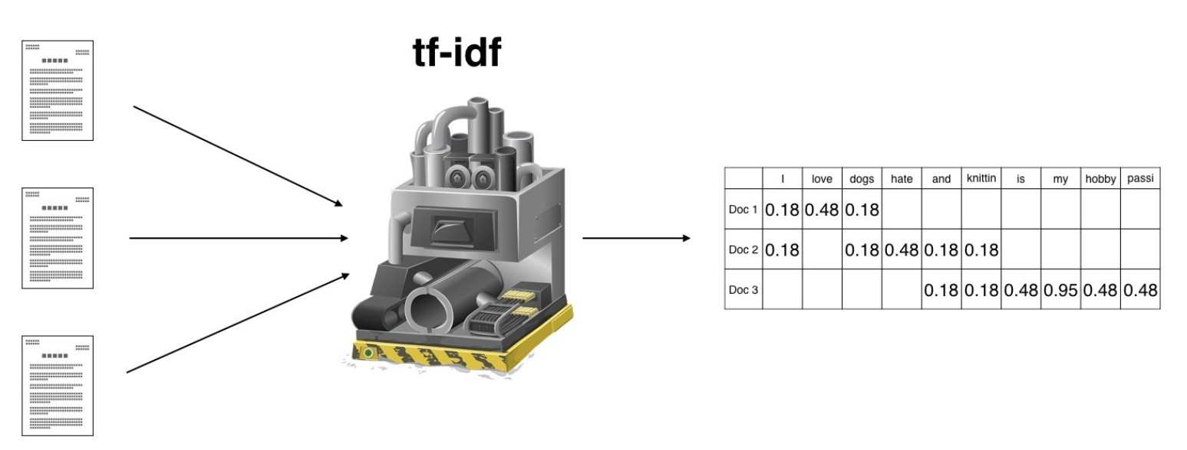

Slide 24

TF-IDF model
Suppose we want to mine the business reviews of people on Yelp.

Slide 25
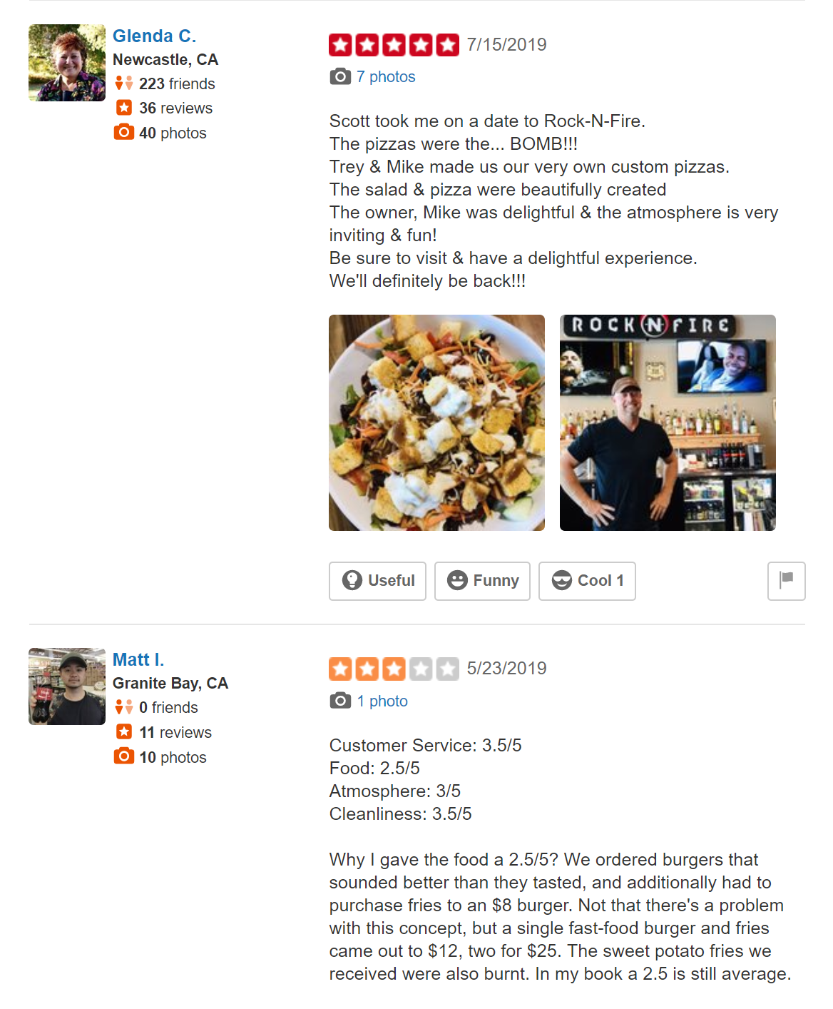
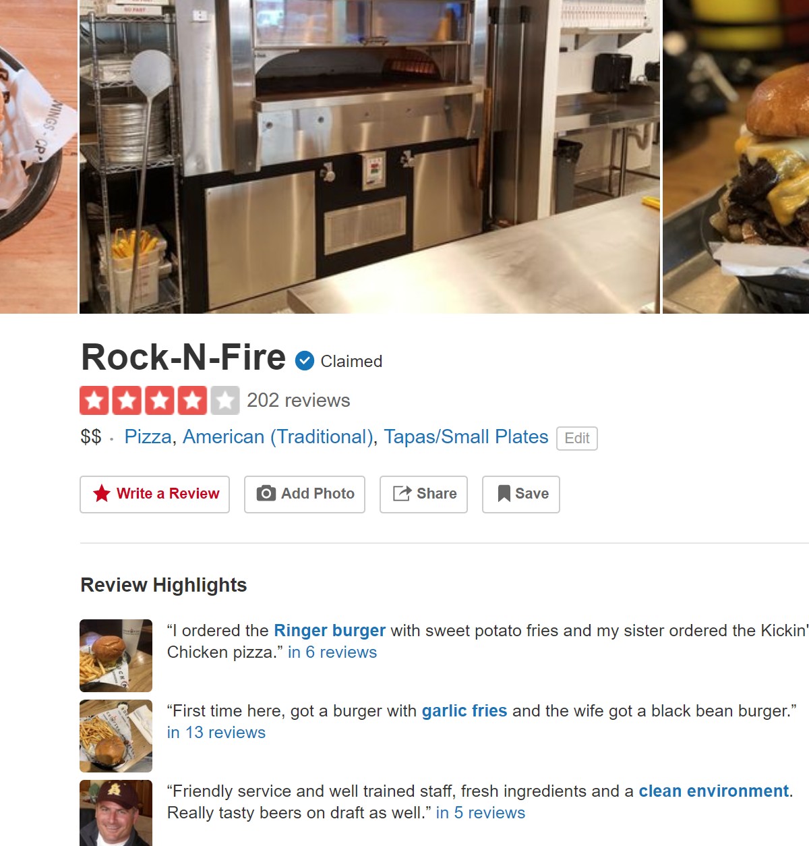
Yelp screenshots

Slide 26
Data collection
Collect all reviews for restaurants in NY in Yelp
Yelp API gives you each review in JSON format
https://www.yelp.com/developers
{"votes": {"funny": 0, "useful": 2, "cool": 1},
"user_id": "Xqd0DzHaiyRqVH3WRG7hzg",
"review_id": "15SdjuK7DmYqUAj6rjGowg",
"stars": 5, "date": "2007-05-17",
"text": "I heard so many good things about this place so I was pretty juiced to try it. I'm from Cali and I heard Shake Shack is comparable to IN-N-OUT and I gotta say, Shake Shake wins hands down. Surprisingly, the line was short and we waited about 10 MIN. to order. I ordered a regular cheeseburger, fries and a black/white shake. So yummerz. I love the location too! It's in the middle of the city and the view is breathtaking. Definitely one of my favorite places to eat in NYC.",
"type": "review",
"business_id": "vcNAWiLM4dR7D2nwwJ7nCA"}

Slide 27
Flat text data (one file per business)
I heard so many good things about this place so I was pretty juiced to try it. I'm from Cali and I heard Shake Shack is comparable to IN-N-OUT and I gotta say, Shake Shake wins hands down. Surprisingly, the line was short and we waited about 10 MIN. to order. I ordered a regular cheeseburger, fries and a black/white shake. So yummerz. I love the location too! It's in the middle of the city and the view is breathtaking. Definitely one of my favorite places to eat in NYC.
I'm from California and I must say, Shake Shack is better than IN-N-OUT, all day, err'day.
Would I pay $15+ for a burger here? No. But for the price point they are asking for, this is a definite bang for your buck (though for some, the opportunity cost of waiting in line might outweigh the cost savings) Thankfully, I came in before the lunch swarm descended and I ordered a shake shack (the special burger with the patty + fried cheese &amp; portabella topping) and a coffee milk shake. The beef patty was very juicy and snugly packed within a soft potato roll. On the downside, I could do without the fried portabella-thingy, as the crispy taste conflicted with the juicy, tender burger. How does shake shack compare with in-and-out or 5-guys? I say a very close tie, and I think it comes down to personal affliations. On the shake side, true to its name, the shake was well churned and very thick and luscious. The coffee flavor added a tangy taste and complemented the vanilla shake well. Situated in an open space in NYC, the open air sitting allows you to munch on your burger while watching people zoom by around the city. It's an oddly calming experience, or perhaps it was the food coma I was slowly falling into. Great place with food at a great price.

Slide 28
First cut
Remove punctuation, make into lower case, clear white spaces,
For each business, break into words, keep the most popular words
the 27514
and 14508
i 13088
a 12152
to 10672
of 8702
ramen 8518
was 8274
is 6835
it 6802
in 6402
for 6145
but 5254
that 4540
you 4366
with 4181
pork 4115
my 3841
this 3487
wait 3184
not 3016
we 2984
at 2980
on 2922
the 16710
and 9139
a 8583
i 8415
to 7003
in 5363
it 4606
of 4365
is 4340
burger 432
was 4070
for 3441
but 3284
shack 3278
shake 3172
that 3005
you 2985
my 2514
line 2389
this 2242
fries 2240
on 2204
are 2142
with 2095
the 16010
and 9504
i 7966
to 6524
a 6370
it 5169
of 5159
is 4519
sauce 4020
in 3951
this 3519
was 3453
for 3327
you 3220
that 2769
but 2590
food 2497
on 2350
my 2311
cart 2236
chicken 2220
with 2195
rice 2049
so 1825
the 14241
and 8237
a 8182
i 7001
to 6727
of 4874
you 4515
it 4308
is 4016
was 3791
pastrami 3748
in 3508
for 3424
sandwich 2928
that 2728
but 2715
on 2247
this 2099
my 2064
with 2040
not 1655
your 1622
so 1610
have 1585
What can you observe?

Slide 29
First cut
Remove punctuation, make into lower case, clear white spaces,
For each business, break into words, keep the most popular words
the 27514
and 14508
i 13088
a 12152
to 10672
of 8702
ramen 8518
was 8274
is 6835
it 6802
in 6402
for 6145
but 5254
that 4540
you 4366
with 4181
pork 4115
my 3841
this 3487
wait 3184
not 3016
we 2984
at 2980
on 2922
the 16710
and 9139
a 8583
i 8415
to 7003
in 5363
it 4606
of 4365
is 4340
burger 432
was 4070
for 3441
but 3284
shack 3278
shake 3172
that 3005
you 2985
my 2514
line 2389
this 2242
fries 2240
on 2204
are 2142
with 2095
the 16010
and 9504
i 7966
to 6524
a 6370
it 5169
of 5159
is 4519
sauce 4020
in 3951
this 3519
was 3453
for 3327
you 3220
that 2769
but 2590
food 2497
on 2350
my 2311
cart 2236
chicken 2220
with 2195
rice 2049
so 1825
the 14241
and 8237
a 8182
i 7001
to 6727
of 4874
you 4515
it 4308
is 4016
was 3791
pastrami 3748
in 3508
for 3424
sandwich 2928
that 2728
but 2715
on 2247
this 2099
my 2064
with 2040
not 1655
your 1622
so 1610
have 1585
Most frequent words are stop words

Slide 30
Second cut
After removing stop words…
ramen 8572
pork 4152
wait 3195
good 2867
place 2361
noodles 2279
ippudo 2261
buns 2251
broth 2041
like 1902
just 1896
get 1641
time 1613
one 1460
really 1437
go 1366
food 1296
bowl 1272
can 1256
great 1172
best 1167
burger 4340
shack 3291
shake 3221
line 2397
fries 2260
good 1920
burgers 1643
wait 1508
just 1412
cheese 1307
like 1204
food 1175
get 1162
place 1159
one 1118
long 1013
go 995
time 951
park 887
can 860
best 849
sauce 4023
food 2507
cart 2239
chicken 2238
rice 2052
hot 1835
white 1782
line 1755
good 1629
lamb 1422
halal 1343
just 1338
get 1332
one 1222
like 1096
place 1052
go 965
can 878
night 832
time 794
long 792
people 790
pastrami 3782
sandwich 2934
place 1480
good 1341
get 1251
katz's 1223
just 1214
like 1207
meat 1168
one 1071
deli 984
best 965
go 961
ticket 955
food 896
sandwiches 813
can 812
beef 768
order 720
pickles 699
time 662
What can you observe?

Slide 31
Second cut
After removing stop words…
ramen 8572
pork 4152
wait 3195
good 2867
place 2361
noodles 2279
ippudo 2261
buns 2251
broth 2041
like 1902
just 1896
get 1641
time 1613
one 1460
really 1437
go 1366
food 1296
bowl 1272
can 1256
great 1172
best 1167
burger 4340
shack 3291
shake 3221
line 2397
fries 2260
good 1920
burgers 1643
wait 1508
just 1412
cheese 1307
like 1204
food 1175
get 1162
place 1159
one 1118
long 1013
go 995
time 951
park 887
can 860
best 849
sauce 4023
food 2507
cart 2239
chicken 2238
rice 2052
hot 1835
white 1782
line 1755
good 1629
lamb 1422
halal 1343
just 1338
get 1332
one 1222
like 1096
place 1052
go 965
can 878
night 832
time 794
long 792
people 790
pastrami 3782
sandwich 2934
place 1480
good 1341
get 1251
katz's 1223
just 1214
like 1207
meat 1168
one 1071
deli 984
best 965
go 961
ticket 955
food 896
sandwiches 813
can 812
beef 768
order 720
pickles 699
time 662
Commonly used words in reviews, not so interesting

Slide 32
Importance measure: Term Frequency (TF)
TF(w,d): term frequency of word w in document d
A measure of importance of a word w for a document d
TF(w,d): = (Number of times w appears in d) / (Total number of terms in d).

Slide 33
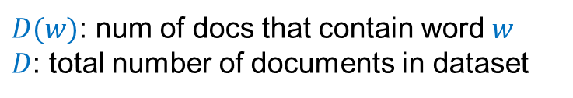
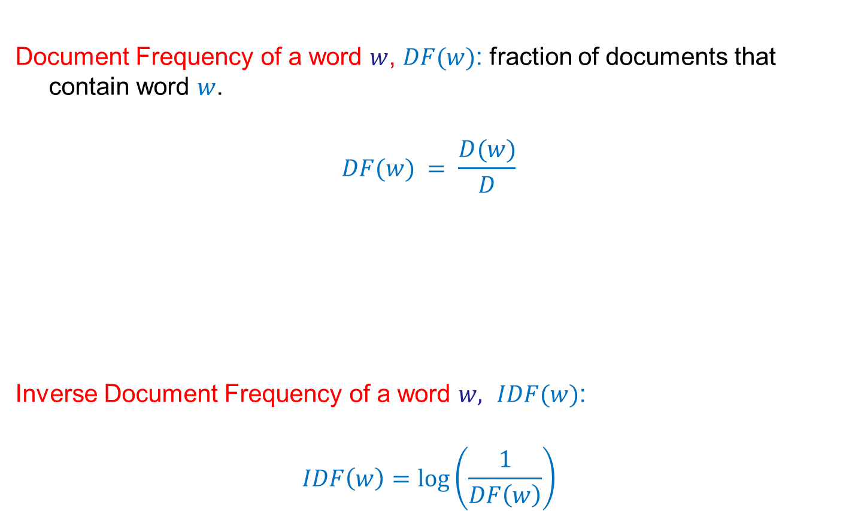
Uniqueness measure: Inverse Document Frequency (IDF)
Document Frequency of a word $w$, $DF(w)$: fraction of documents that contain word $w$.
$$DF(w) = \frac{D(w)}{D}$$
Inverse Document Frequency of a word $w,$ $IDF(w)$:
$$IDF\left(w\right)=\log\left(\frac{1}{DF\left(w\right)}\right)$$
$D(w)$: num of docs that contain word $w$
$D$: total number of documents in dataset

Slide 34
TF-IDF
For document analysis, we are more interested in the words that are not only important for the document, but also unique to the document.
TF(w,d): term frequency of word w in document d
A measure of importance of the word w for the document d
IDF(w): inverse document frequency
A measure of the uniqueness of the word w
TF-IDF(w,d) = TF(w,d) × IDF(w)

Slide 35
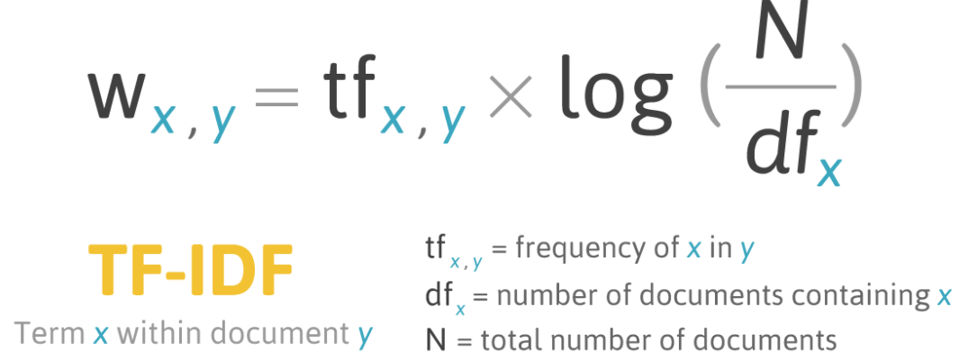
TF-IDF: put everything together

Slide 36
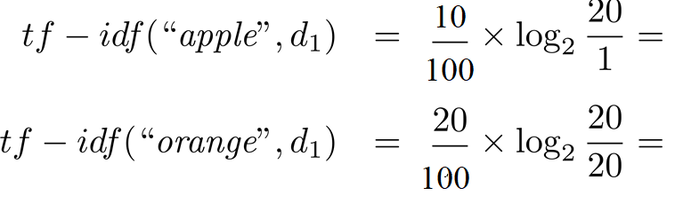
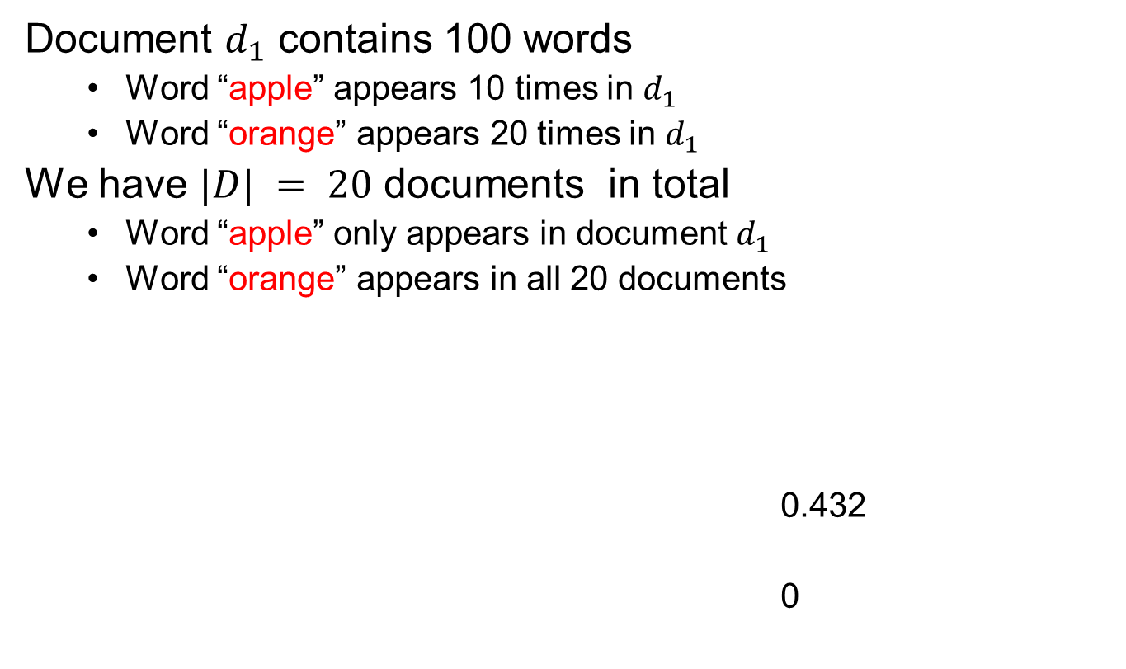
TF-IDF: An Example
Document $d_{1}$ contains 100 words
Word “apple” appears 10 times in $d_{1}$
Word “orange” appears 20 times in $d_{1}$
We have $|D| = 20$ documents in total
Word “apple” only appears in document $d_{1}$
Word “orange” appears in all 20 documents
0.432
0

Slide 37
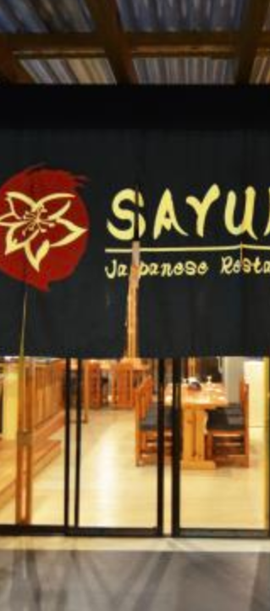
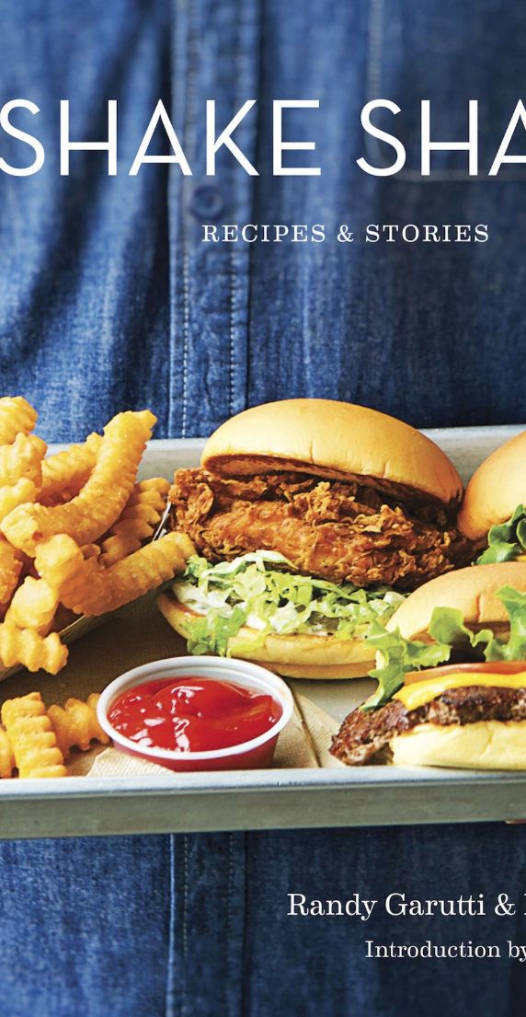
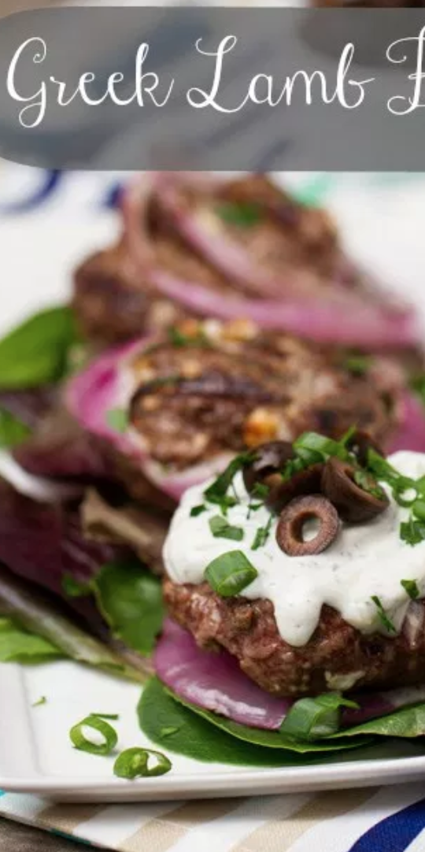
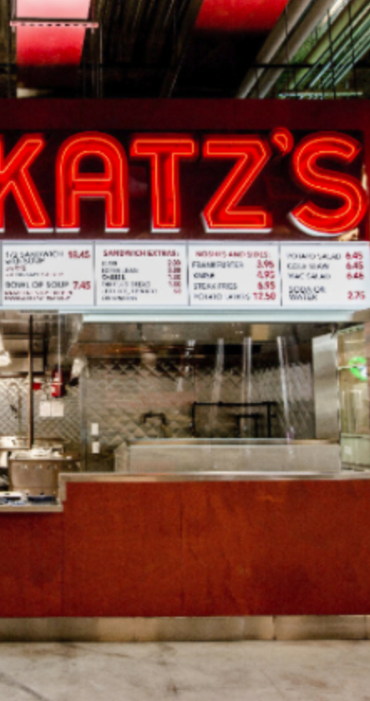
Third cut
Order all the words by TF-IDF per document
ramen 3057.41761944282 7
akamaru 2353.24196503991 1
noodles 1579.68242449612 5
broth 1414.71339552285 5
miso 1252.60629058876 1
hirata 709.196208642166 1
hakata 591.76436889947 1
shiromaru 587.1591987134 1
noodle 581.844614740089 4
tonkotsu 529.594571388631 1
ippudo 504.527569521429 8
buns 502.296134008287 8
ippudo's 453.609263319827 1
modern 394.839162940177 7
egg 367.368005696771 5
shoyu 352.295519228089 1
chashu 347.690349042101 1
karaka 336.177423577131 1
kakuni 276.310211159286 1
ramens 262.494700601321 1
bun 236.512263803654 6
wasabi 232.366751234906 3
dama 221.048168927428 1
brulee 201.179739054263 2
fries 806.085373301536 7
custard 729.607519421517 3
shakes 628.473803858139 3
shroom 515.779060830666 1
burger 457.264637954966 9
crinkle 398.34722108797 1
burgers 366.624854809247 8
madison 350.939350307801 4
shackburger 292.428306810 1
'shroom 287.823136624256 1
portobello 239.8062489526 2
custards 211.837828555452 1
concrete 195.169925889195 4
bun 186.962178298353 6
milkshakes 174.9964670675 1
concretes 165.786126695571 1
portabello 163.4835416025 1
shack's 159.334353330976 2
patty 152.226035882265 6
ss 149.668031044613 1
patties 148.068287943937 2
cam 105.949606780682 3
milkshake 103.9720770839 5
lamps 99.011158998744 1
lamb 985.655290756243 5
halal 686.038812717726 6
53rd 375.685771863491 5
gyro 305.809092298788 3
pita 304.984759446376 5
cart 235.902194557873 9
platter 139.459903080044 7
chicken/lamb 135.8525204 1
carts 120.274374158359 8
hilton 84.2987473324223 4
lamb/chicken 82.8930633 1
yogurt 70.0078652365545 5
52nd 67.5963923222322 2
6th 60.7930175345658 9
4am 55.4517744447956 5
yellow 54.4470265206673 8
tzatziki 52.9594571388631 1
lettuce 51.3230168022683 8
sammy's 50.656872045869 1
sw 50.5668577816893 3
platters 49.9065970003161 5
falafel 49.4796995212044 4
sober 49.2211422635451 7
moma 48.1589121730374 3
pastrami 1931.94250908298 6
katz's 1120.62356508209 4
rye 1004.28925735888 2
corned 906.113544700399 2
pickles 640.487221580035 4
reuben 515.779060830666 1
matzo 430.583412389887 1
sally 428.110484707471 2
harry 226.323810772916 4
mustard 216.079238853014 6
cutter 209.535243462458 1
carnegie 198.655512713779 3
katz 194.387844446609 7
knish 184.206807439524 1
sandwiches 181.415707218 8
brisket 131.945865389878 4
fries 131.613054313392 7
salami 127.621117258549 3
knishes 124.339595021678 1
delicatessen 117.488967607 2
deli's 117.431839742696 1
carver 115.129254649702 1
brown's 109.441778045519 2
matzoh 108.22149937072 1

Slide 38
Done!
Now, we get the TF-IDF vector for each document (restaurant), which are ready to be sent to models as input

Slide 39

Modeling and evaluation

Slide 40

Machine learning
A study on getting a computer to finish a task without explicitly programming it

Slide 41
Learning types
Unsupervised (data has no labels)
Supervised (all data are labeled)

Slide 42
Machine Learning in a nutshell
 | Supervised Learning | Unsupervised Learning
Continuous Output | Regression (linear regression, neural networks,…) | Dimensionality reduction
Discrete Output | Classification (KNN, SVM, decision tree, Bayes classifier, logistic regression, neural networks…) | Clustering (k-means, hierarchical clustering, DBSCAN, GMM…)

Slide 43
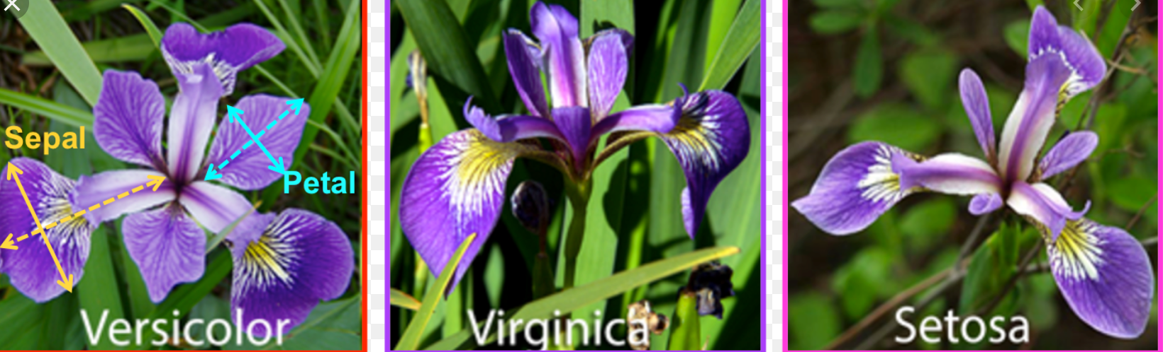
Classification
Learn a model from labeled data and make prediction on labels.
Predict the species of Iris flower (setosa, virginica and versicolor)

Slide 44
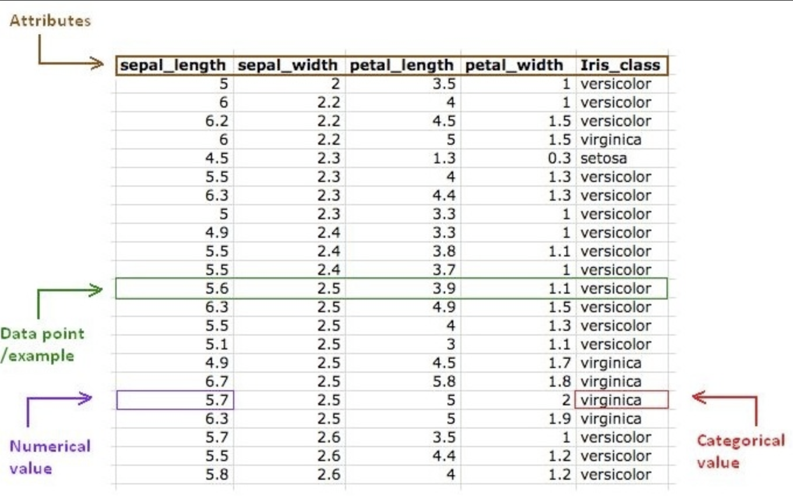
Classification

Slide 45
Steps in classification
Define the problem
What you are trying to predict?
Identify input features
Find the features that help to discriminate between the classes
Identify output labels
Decide on which model to train
What is the right model for your problem?
Train the model on training data
Test the model on test data

Slide 46
Any model
y = f_{Θ}(x)
Output(label)
function
Input (features)

Slide 47

Collecting data for computer vision
apple
pear
tomato
cow
dog
horse

Slide 48
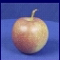
Machine learning pipeline
Learning
Training Labels
Training Samples
Features
Training
y = f_{Θ}(x)
Inference
Features
y = f_{Θ}( )
y = apple
Test Sample

Slide 49
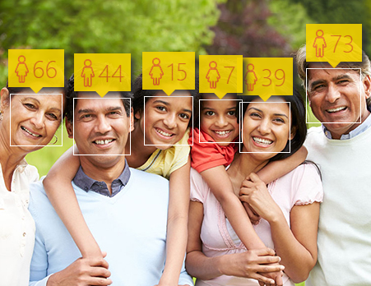
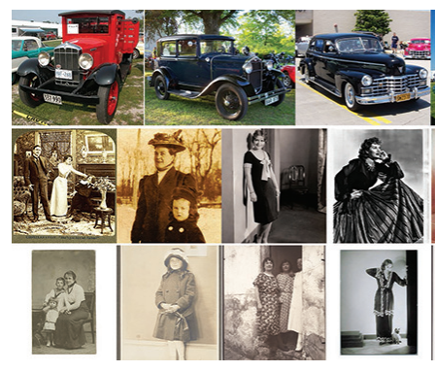
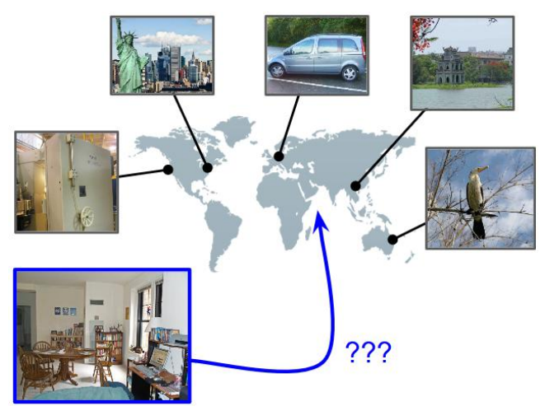
Regression
Age estimation
When was that made?
IM2GPS

Slide 50
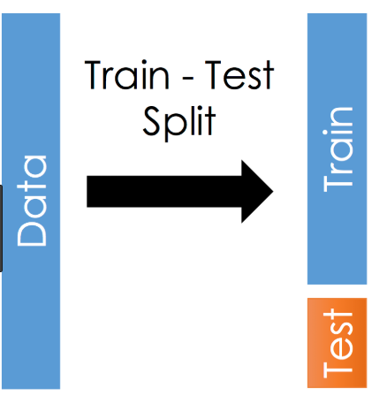
Model evaluation
Split data into two separate parts
Learn parameters on the training set
Evaluate performance on the test set
~70% of records used for training, ~30% for testing

Slide 51
ML model evaluation
The ultimate goal of evaluation should be:
MAXIMIZE the ability of the model to predict new (out-of-sample) data.

Slide 52
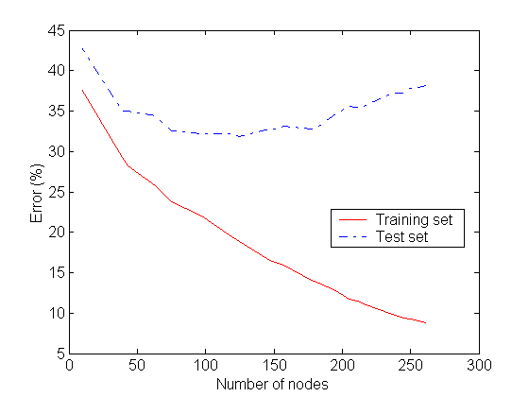
Underfitting and Overfitting
Underfitting
Overfitting
Underfitting: when model is too simple, both training and test errors are large
Overfitting: when model is too complex it models the details of the training set and fails to generalize well on the test set

Slide 53
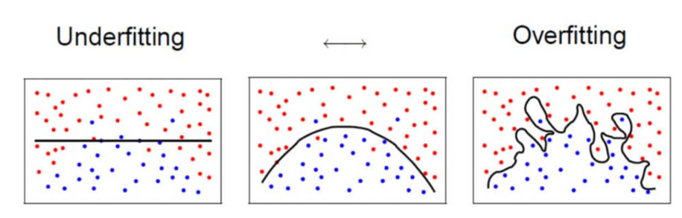
Underfitting and Overfitting

Slide 54
How to avoid underfitting and overfitting?
Train model parameters on training set
Test model performance on test set
Stop training once the test error goes up!
What metrics should be used to measure test error?

Slide 55
Metric used to evaluate model on test data
Classification
Precision
Recall
F1-score
ROC curve
Regression
RMSE (Root Mean Squared Error)
R2 score

Slide 56
Precision, Recall, F1-score
Precision: Out of records labeled as positive, how many are actually positive?
Recall: How many positive records are labeled correctly?
F-measure (F1-score): It combines precision and recall and can be used as a single summary number for model quality

Slide 57
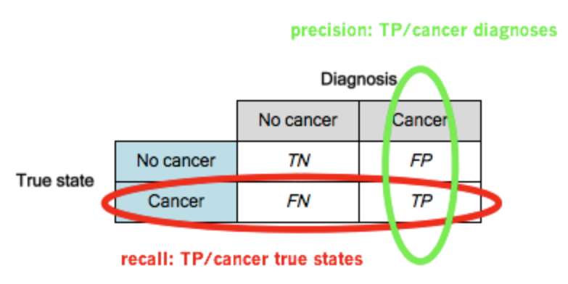
Confusion matrix (binary problem)
 | PREDICTED CLASS
ACTUAL CLASS |  | Class=No | Class=Yes
 | Class=No | a (TN) | b (FP)
 | Class=Yes | c (FN) | d (TP)

Slide 58
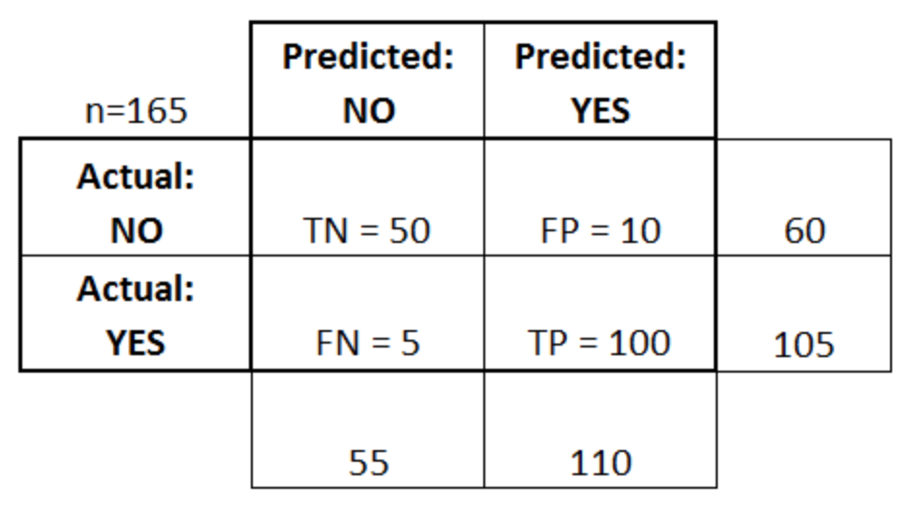
Confusion matrix
Confusion matrix about a model used to predict whether a tumor is malignant (NO) or benign (YES)

Slide 59
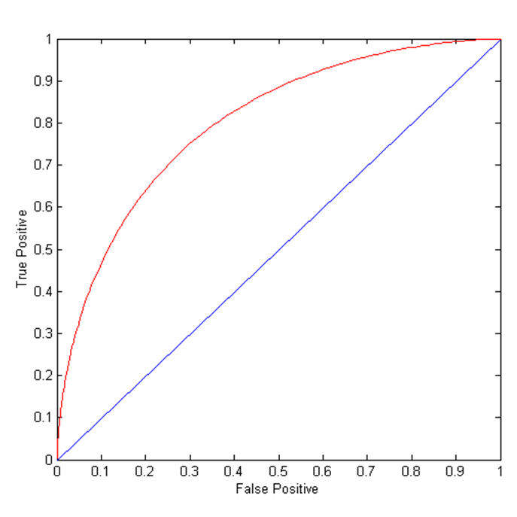
ROC Curve
ROC curve plots TPR (true positive rate) (on the y-axis) against FPR (false positive rate) (on the x-axis)
 | PREDICTED CLASS
ACTUAL CLASS |  | Class=No | Class=Yes
 | Class=No | a (TN) | b (FP)
 | Class=Yes | c (FN) | d (TP)
Notes:
TPR = sensitivity
FPR = 1- selectivity

Slide 60
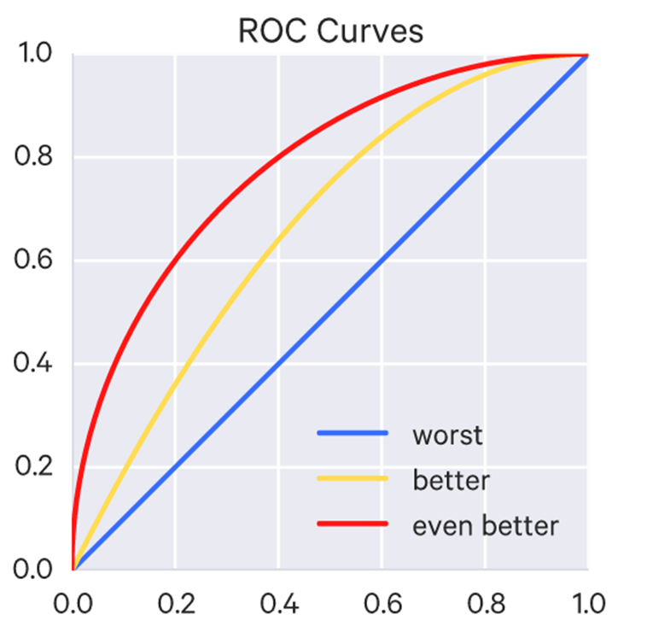
Using ROC for Model Comparison
Area Under Curve (AUC) determines which models preforms best
Ideal: Area = 1
Random guess（= Diagonal line）:
Area = 0.5

